Slide 1
Serial peripheral interface (spi)

Slide 2
Why?
Simpler wiring
Efficiency increases for serial communication
Clock frequencies > MHz
No limitation in measuring area, also in the audio field transmission

Slide 3
SPI is...
Serial Peripheral Interface (SPI) is an interface bus commonly used to send data between microcontrollers and small peripherals such as shift registers, sensors, and SD cards. It uses separate clock and data lines, along with a select line to choose the device you wish to talk to.

Slide 4
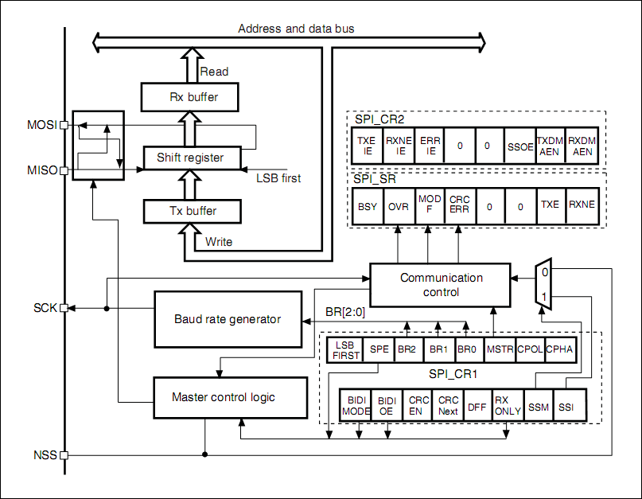

Slide 5
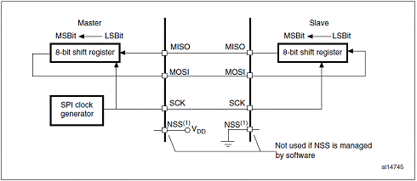

Slide 6
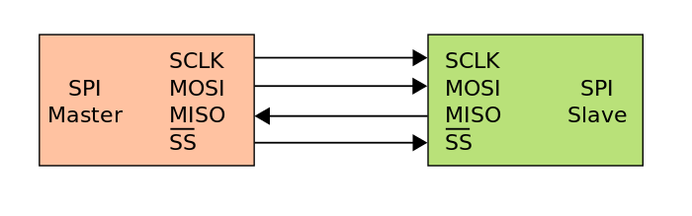

Slide 7
Master output, slave input (mosi)
This pin can be used to transmit data in slave mode and receive data in master mode.

Slide 8
Master input, slave output (miso)
This pin can be used to transmit data in master mode and receive data in slave mode.

Slide 9
Serial clock (SCK)
This pin is to output for SPI masters and input for SPI slaves

Slide 10
Slave select (NSS)
An optional pin to select slave device.
Let spi master to communicate with slaves individually and avoid contention on the data lines.
Usually active low and output from master – operates at master mode

Slide 11
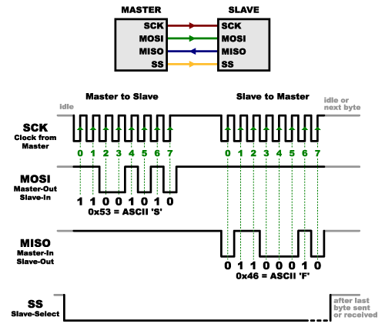

Slide 12
Types of slave configuration for NSS
Independent slave configuration
Daisy chain configuration

Slide 13
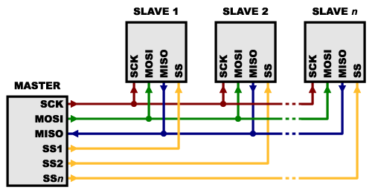
Independent slave configuration

Slide 14
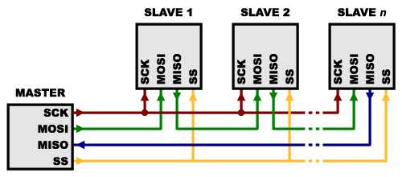
Daisy chain configuration (Shift register)

Slide 15
Two types of clock
Clock polarity (CPOL)
Clock phase (CPHA)
*are the main parameters that define a clock format to be used by the SPI bus.

Slide 16
Clock polarity (CPOL)
controls the steady state value of the clock when no data is being transferred.
Will affect both master and slave modes.
CPOL=0; SCK = low level idle level
CPOL=1; SCK = high-level idle level

Slide 17
Clock phase (CPHA)
CPHA = 1; the second edge of the SCK pin is the MSBit capture strobe.
falling edge if the CPOL bit is reset, rising edge if the CPOL bit is set.
Data are latched on the occurrence of the second clock transition.
CPHA = 0; the first edge of the SCK pin is the MSBit capture strobe.
falling edge if CPOL bit is set, rising edge if CPOL bit is reset.
Data are latched on the occurrence of the first clock transition.

Slide 18
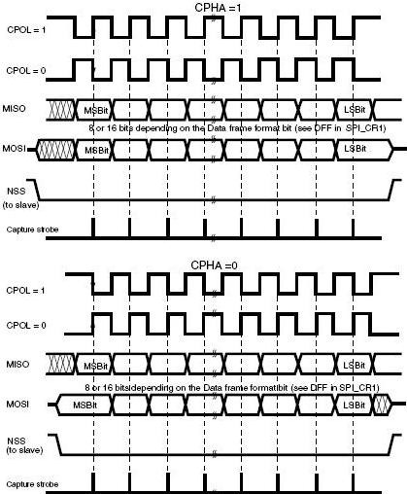

Slide 19
Combination of CPOL and cpha
selects the data capture clock edge.
Data will be captured at the clock edge as stated by the strobe and output at the next edge.
Eg: Data captured at rising edge and output at failing edge.

Slide 20
SPI modes (configuration)
Master mode
Slave mode

Slide 21
Master mode
The serial clock is generated on the SCK pin.

Slide 22
slave mode
The serial clock is received on the SCK pin from the master device.
* enable the SPI slave before the master sends the clock.
If not, undesired data transmission may occur.
The data register of the slave needs to be ready before the first edge of the communication clock or before the end of the ongoing communication.

Slide 23
Cyclic Redundancy check (CRC)
Implemented for communication reliability.
Separate CRC calculators are implemented for transmitted data and received data.
Calculated using a programmable polynomial serially on each bit.
Calculated on the sampling clock edge defined by the CPHA and CPOL bits in the SPI_CR1 register.
Offers two kinds of CRC calculation standard which depend directly on the data frame format selected for the transmission or reception: CR8 (8-bits )or CR16 (16-bits)

Slide 24
Communication using DMa
Enable the bit in SPI_CR2 register to use DMA.
DMA request is issued each time TXE or RXNE is set to 1. DMA will write to data register or read the data register. (TXE flag & RXNE flag will be cleared.)

Slide 25
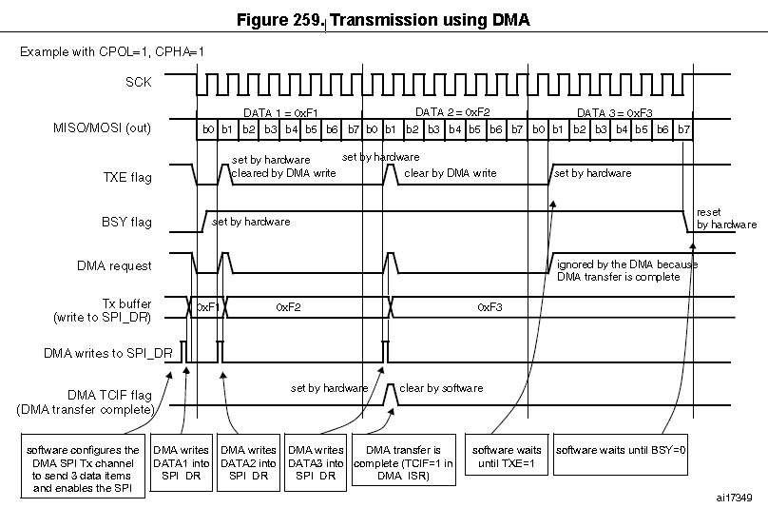

Slide 26
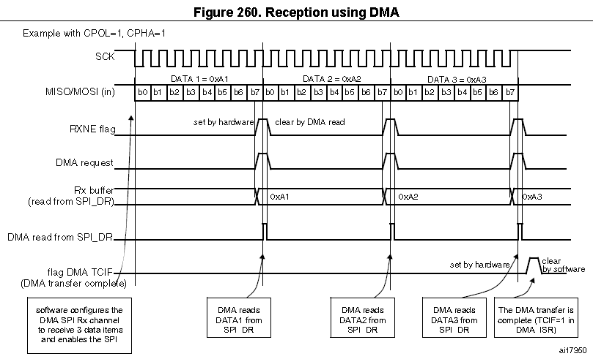

Slide 27
Flags
Status flag - 4 status flags to fully monitor the state of SPI
Tx buffer empty flag (TXE)
when set, Tx buffer is empty and ready to be loaded for the next data.
when reset, the data is writing to the SPI_DR register.
Rx buffer not empty (RXNE)
when set, valid received data exists in the Rx buffer.
when reset, SPI_DR is reading the data.
BUSY flag
Error flag

Slide 28
Busy flag
indicates the state of the communication layer of SPI.
when set, SPI is busy communicating. (Transmission starts)
exception in master mode / bidirectional receive mode. (BUSY flag = 0)
Useful to detect the end of the transfer if the software wants to disable the SPI and enter HALT mode.
avoid corrupting the last transfer.
Useful to avoid write collisions in a multimaster system.

Slide 29
Error flags
Master mode fault (MODF)
Overrun condition
CRC error
TI mode frame format error

Slide 30
Master mode fault (modf)
MODF bit is set and SPI interrupt is generated if the EERIE bit is set.
SPE is cleared.
Blocks all the output from the device and disables the SPI interface.
Master becomes slave. (MSTR is cleared)
NSS pin pulled low or SSI bit low at Master mode

Slide 31
Overrun condition
When data has sent data bytes and the slave device has not cleared the RXNE bit resulting from the previous data byte transmitted.
OVR bit is set and an interrupt is generated if ERRIE bit is set.
The receive buffer from the Slave device will not be updated and all the subsequently transmitted data will disappear.
OVR bit is cleared by reading the data from SPI_DR register followed by a read access to the SPI_SR register.

Slide 32
CRC error
CRCERR flag in the SPI_SR register is set.
The shift register does not match with the value in SPI_RXCRCR.

Slide 33
advantages
It’s faster than asynchronous serial.
The receive hardware can be a simple shift register.
It supports multiple slaves.

Slide 34
disadvantages
It requires more signal lines (wires) than other communications methods
The communications must be well-defined in advance (you can’t send random amounts of data whenever you want)
The master must control all communications (slaves can’t talk directly to each other)
It usually requires separate SS lines to each slave, which can be problematic if numerous slaves are needed.

